Slide 1
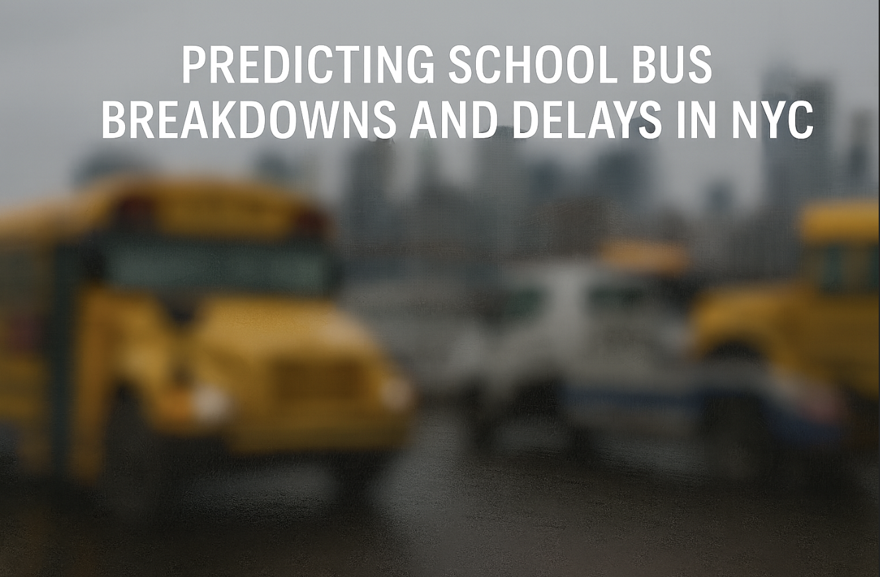
Capstone Project by Team B
Team Members: Nasim Aalemi, Shobha Panthi, James Gilmore
Dataset Link: https://shorturl.at/OSbdS
Github Link: https://github.com/naalemi/Predicting_NYC_School_Bus_Breakdowns_Capstone_Project-Team-B-

Slide 2
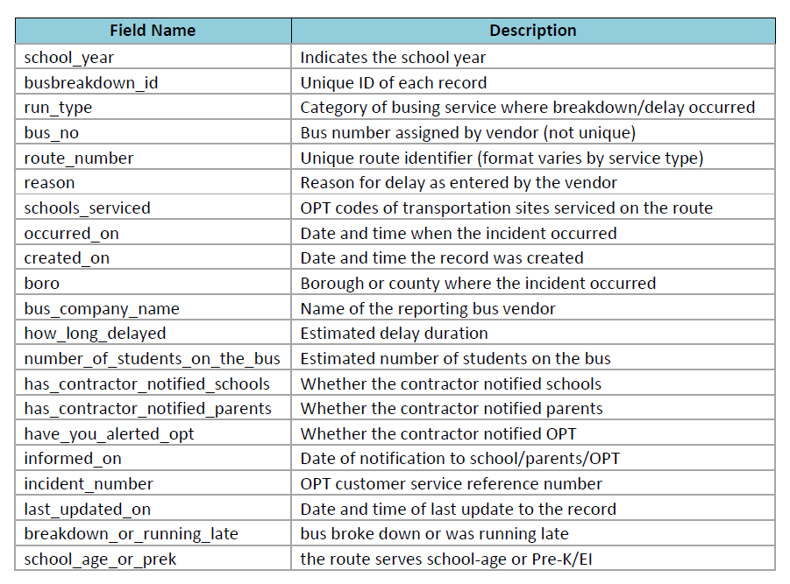
Project Dataset and Overview
Dataset: NYC Breakdown and Delays
Size: 228,427 records
Timeframe: 2022-2025 (3 Years)
Area of focus: Bus Breakdown or Delay (breakdown/running_late)
Using an intricate dataset from the NYC Open Data Portal, we will explore the effects of bus breakdown and delays, as well as offering actionable recommendations to the NYC Department of Education (DOE).
This presentation will feature advanced data analysis, including classification/regression modeling that will allow us to uncover patterns and predict future outcomes.
Our project features front-end tools such as Streamlit and Power-BI that will allow us to generate actionable insights into key areas where the NYC DOE can improve
*** An incident must occur in order for a record to be recorded in this dataset ***

Slide 3
Literature Review
Lack of Comparable Projects on School Bus Delay Prediction
Extensive search of academic journals, data science platforms (e.g., Kaggle), and public sector dashboards revealed very limited or no projects focused on Predictive modeling of school bus delays
Integrated tools or dashboards tailored for school transit performance
What Exists Instead
General transit bus status (e.g.,Transportation Status BCPS)
Bus delay or breakdown report (e.g., NYC Public Schools)
General articles highlighting the significance of minimizing bus delays

Slide 4
Data Quality & Cleaning
The dataset came straight from NYC Open Data (ODP). Data is messy, inconsistent, and not curated. Any model or dashboard built on top of it, will be unreliable and the quality of output is determined by the quality of the input. Therefore, we spent a significant amount of time cleaning and standardizing it to make the data analysis ready before modeling.
Key Data Cleaning Focus Areas:
1) Bus_Company_Name
Problem: Lots of duplicates caused by spelling variants, abbreviations, and punctuation (e.g., “RELIANT TRANS, INC.” vs “RELIANT TRANSPORTATION, INC”).
What we did: Standardized case/spacing/punctuation, stripped special characters, and applied a manual mapping dictionary to collapse aliases into a single canonical company name.
2) Route_Number
Problem: Mixed formats (letters + numbers, plain numbers, timestamps like 10:00, stray symbols like #, leading zeros, and blanks).
What we did: Normalized to uppercase and removed non-alphanumeric characters (e.g., #, spaces). Dropped clear non-routes (time-like strings, “AM/PM” tokens, zeros) and Removed leading zeros and created a cleaned field Route_Number_Clean.

Slide 5
Data Quality & Cleaning
3) How_Long_Delayed
Problem: Delay entered in different styles/units (“15 min”, “30 MINS”, “1 HR”, blank).
What we did: Parsed text to a single numeric Delay_Minutes (converted hours→minutes, handled ranges like “15–20” by taking MEAN), and treated certain blanks as BREAKDOWN
Additional Pre-processing
Parsed Occurred_On/Created_On to datetimes and engineered Hour/Month/Day_of_Week.
We found impossible values in Number_Of_Students_On_The_Bus (some rows had hundreds/thousands), We limited the student count to 72 (a full bus) so unrealistic numbers wouldn’t skew our analysis or predictions.
We removed any record missing core fields (Borough/Run Type/Bus No/Route/Reason) to keep only high-quality data for analysis and modeling.
“GARBAGE IN, GARBAGE OUT”

Slide 6
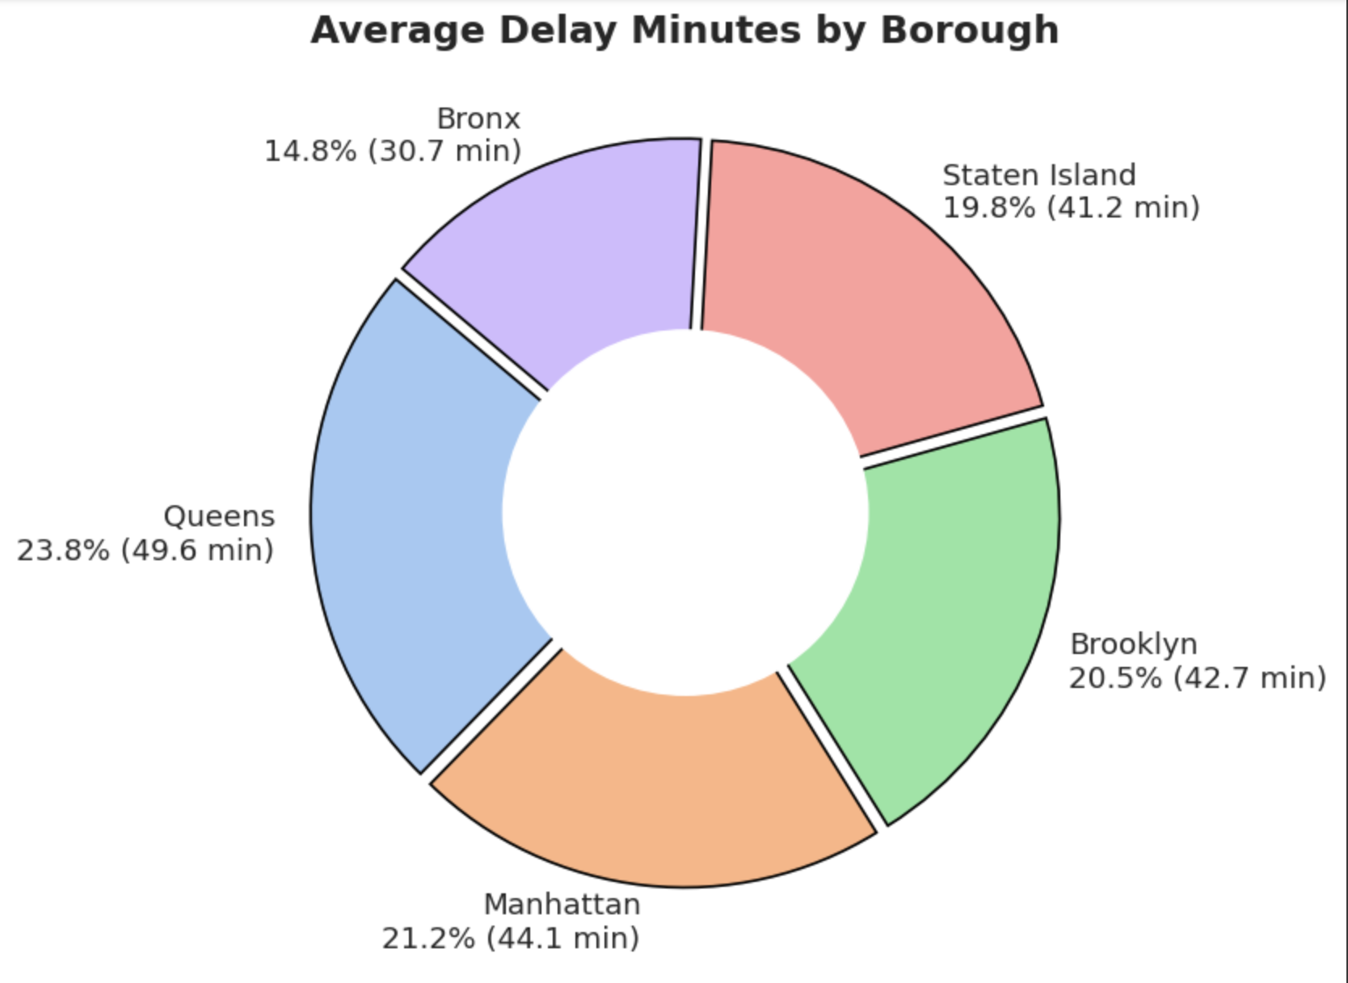
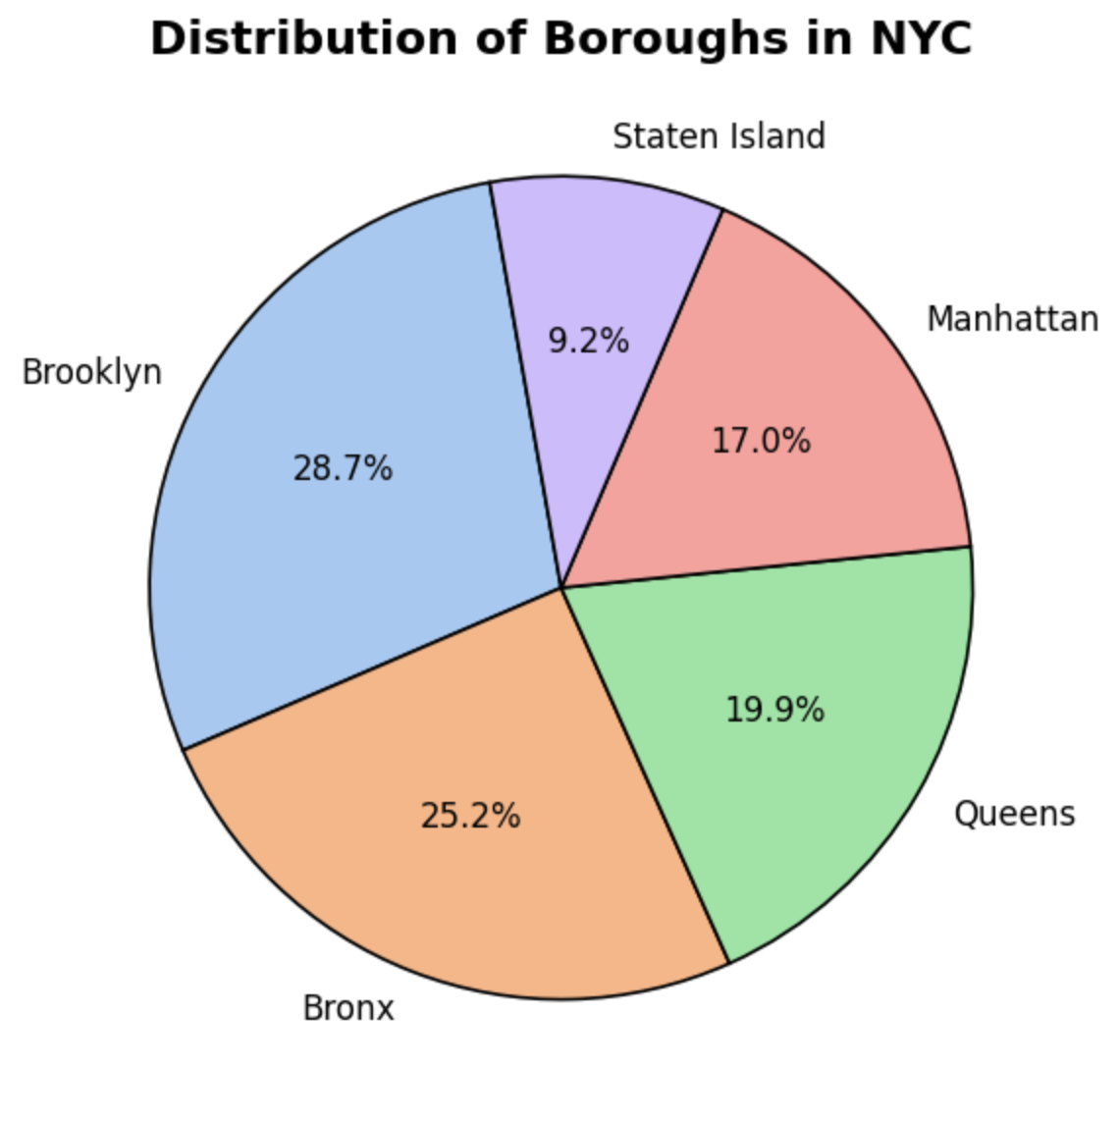
The original dataset contained data of the entire state of New York. Our goal is to focus on New York City (5 boroughs) then we filtered out non-NYC entries to keep only Manhattan, Brooklyn, Queens, Bronx, Staten Island.
The pie chart below now reflects the true distribution of
incidents (Breakdown and Delays) within NYC, avoiding
noise from out-of-city records and keeping the analysis
aligned with our objective.
This chart summarizes average delay minutes by borough and each borough’s share of the system’s total delay time.Queens has the longest and largest share of delays(49.6 min, 23.8%). Manhattan and Brooklyn follow (42.7 min, 20.5% each). Staten Island is slightly lower (41.2 min,19.8%). The Bronx is best(30.7 min, 14.8%).

Slide 7
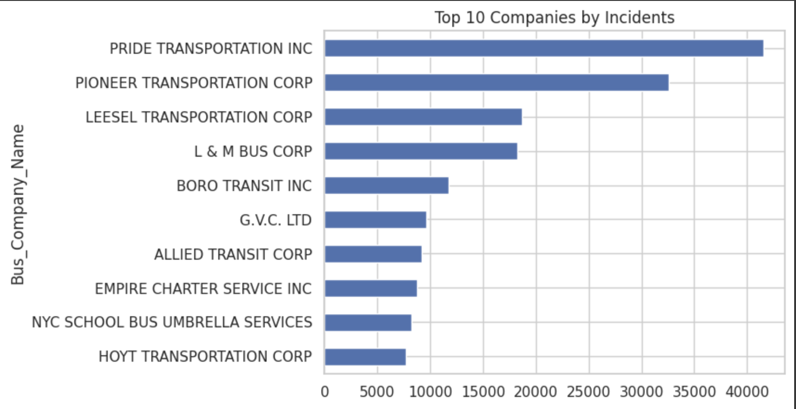
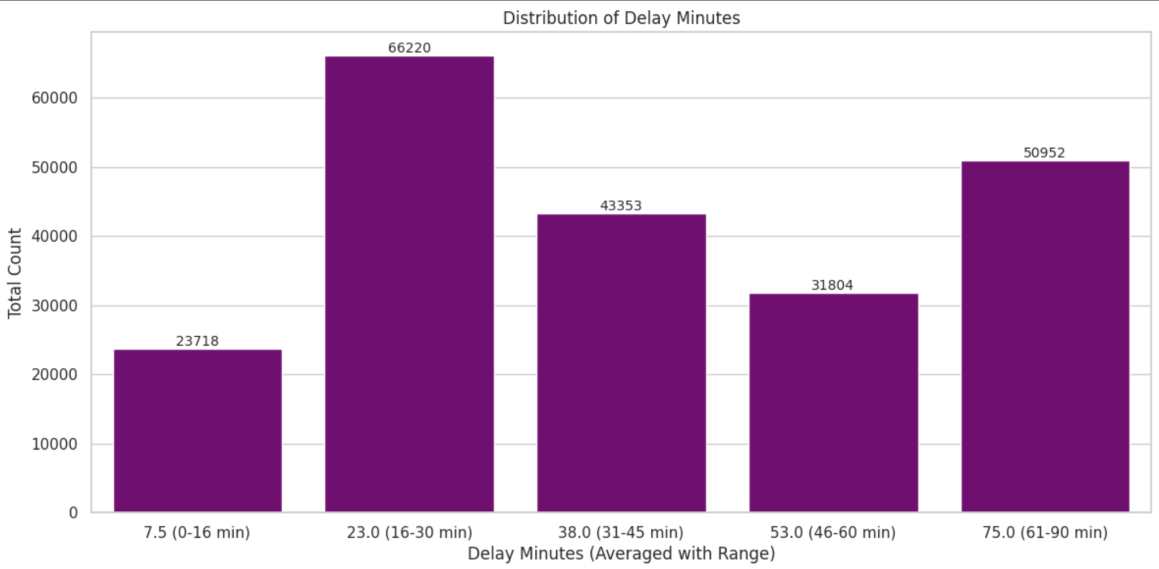
Exploratory Data Analysis
This Top 10 Companies by incidents chart
shows that some companies like Pride and
Pioneer have significantly more incidents. This
could be because they operate more routes or
have maintenance issues. It helps identify
companies that might need more attention
for service quality.
This Distribution of Delay Minutes chart shows delay times into five ranges and counts incidents in each.Most delays are 16–30 minutes (biggest bar). There’s also a lot of long delays (61–90 min), and very few short ones (0–15 min).

Slide 8
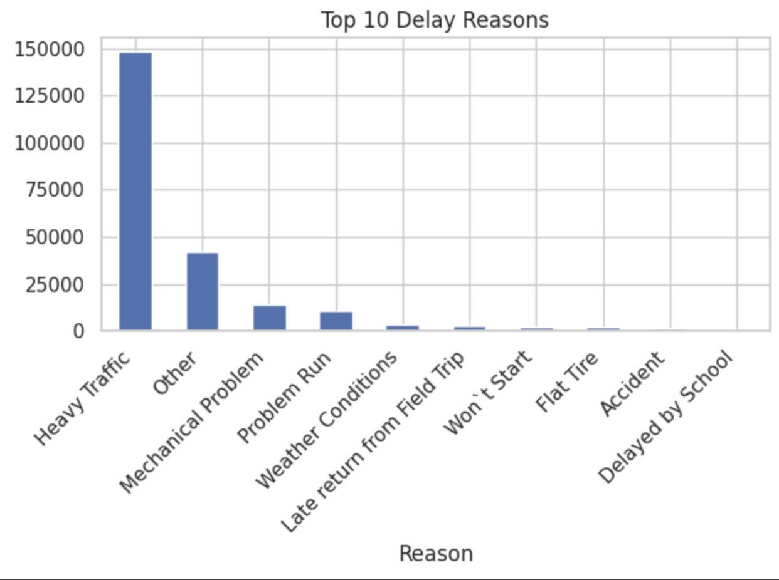
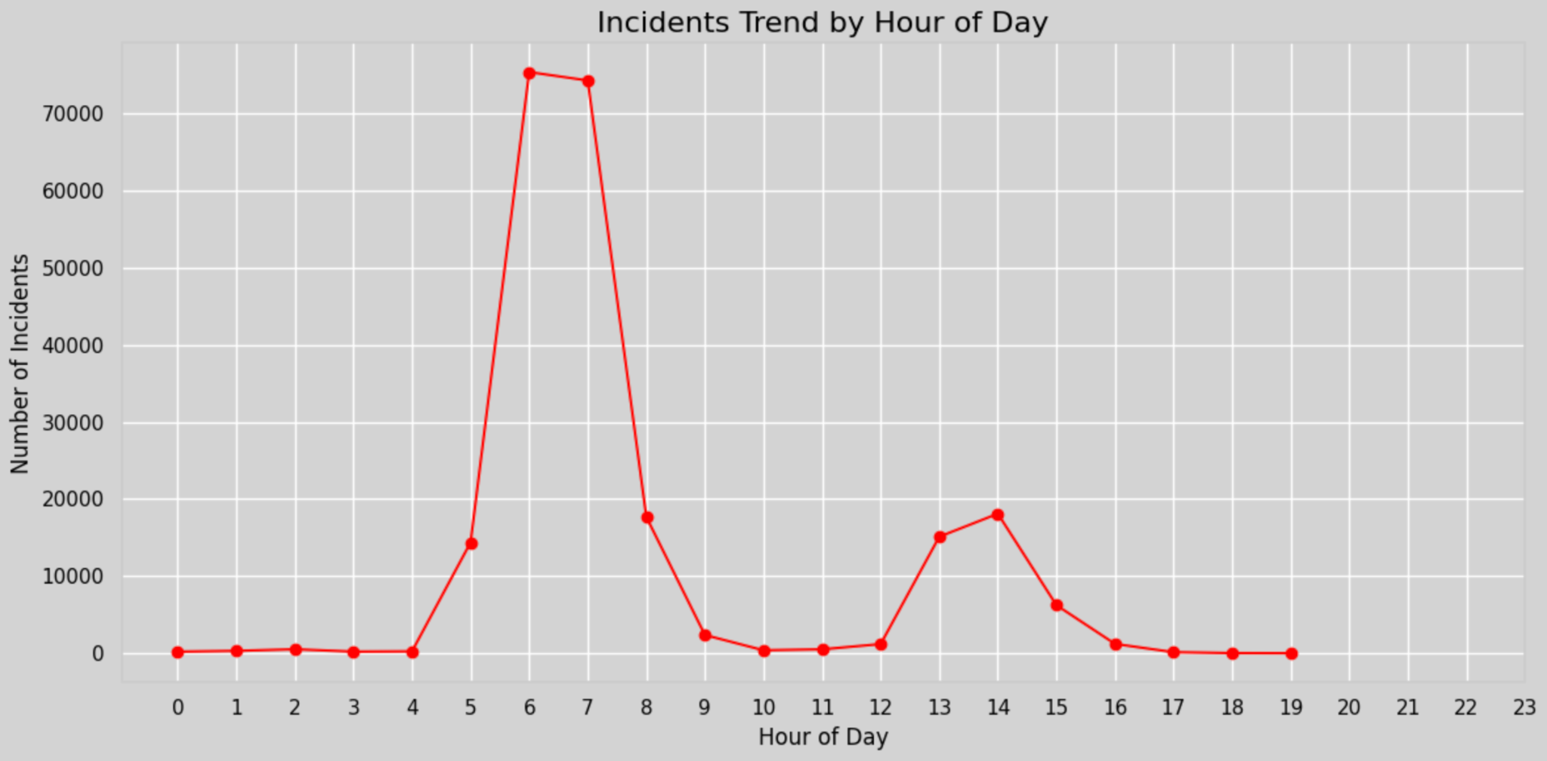
Exploratory Data Analysis
This bar chart shows the top reasons buses are delayed. “Heavy Traffic” dominates by a huge margin, far more than any other category. “Other” is second, followed by “Mechanical Problem,” while the remaining reasons (weather, flat tire, accidents, etc.) occur comparatively rarely.
This line chart shows bus incidents by hour of day. There’s a sharp morning peak (5–7 AM), a smaller afternoon peak (1–3 PM), and very few incidents outside school commute hours.Late night and evening have almost no incidents.

Slide 9
Modeling - Regression using RF Regressor
*** Goal - Predict the delay time (in minutes) for a bus incident ***
Workflow Pipeline: Preprocessing -> Model Training -> Evaluation
Preprocessing - Label Encoding for categorical variables, splitting data (train, test), removed our target variable “Delay_Minutes” from our input columns
Model Training - Used Random Forest Regressor (Parameters: n_estimators = 100, random_state =42)
Features included: Reason, Bus_Company_Name, Run_Type, School_Year, Borough, etc.
Evaluation - Three types of Model Evaluation Methods
Root Mean Squared Error (RMSE): Measures avg error in Delay_Minutes
R2 Score: How well is the model able to predict for our target Delay_Minutes
Feature Importance - Allows us to understand which columns had the most impact on model performance

Slide 10
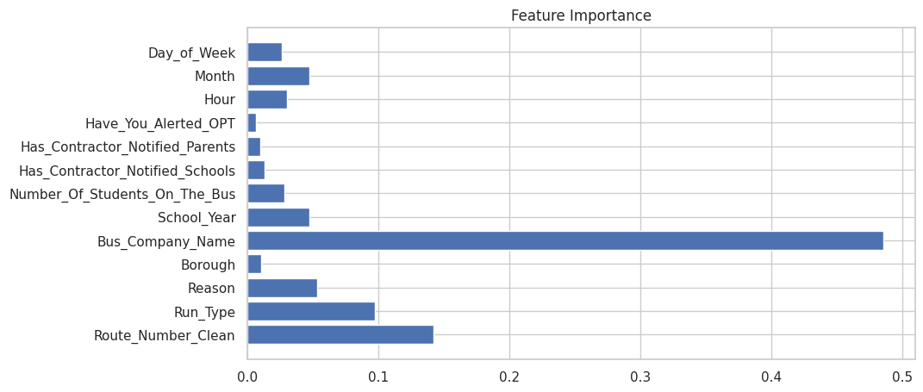
Modeling - Delay Prediction using RF Regressor
Random Forest Regressor – Key Takeaways:
Target Variable: Delay_Minutes (Continuous Value)
Root Mean Square Error (RMSE): ~ 9.65 minutes
The predictions are within 9.65 minutes of actual delays
The average error between actual and predicted
R2 Score: 82% accuracy
The model did a good job predicting how many minutes a delay will be
Based on the model, we can see that the “Bus_Company_Name” column had the most importance when the model was trained

Slide 11
Modeling - Classification using XGBoost
*** Goal - Predict if an incident will a Bus Breakdown or Delay ***
Workflow Pipeline: Preprocessing -> Oversampling Balance -> Model Training -> Evaluation
Preprocessing - Target Encoding for categorical variables, using standardscaler to standardize numeric values, splitting data (train,test,validation)
Oversampling Balance - Applied SMOTE (address oversampling) to handle imbalances
Model Training - Used XGBoost Classifier (Parameters: n_estimators = 200, learning_rate = .05, max_depth = 6)
Evaluation - Three types of Model Evaluation Methods on BOTH validation and testing datasets
Precision: Measurers the accuracy of Positive predictions
Recall: Measurers how the models ability to accurately measure all positive predictions
F1 Score: Measurers predictive performance using Precision and Recall
Support: Counts how many actual occurrences that were in the dataset
Feature Importance - Allows us to understand which columns had the most impact on model performance

Slide 12
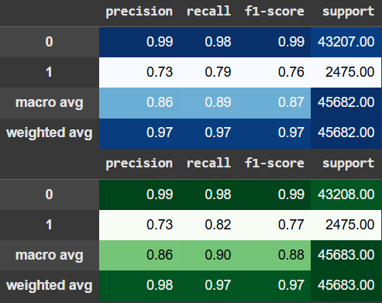
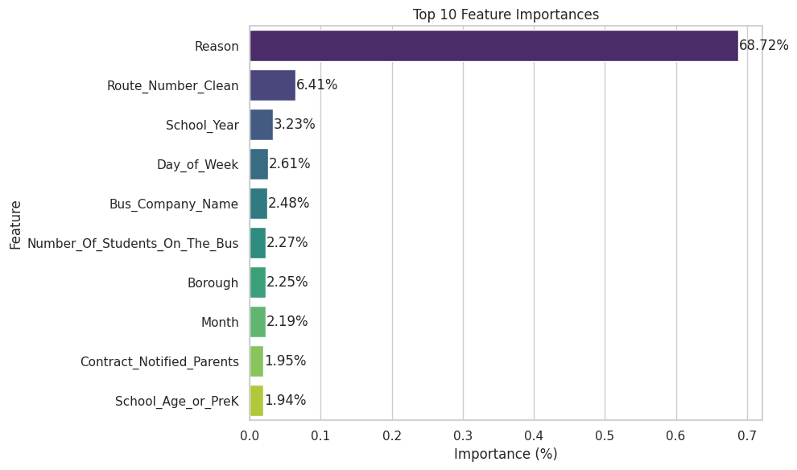
XGBoost:Predicting Breakdowns vs Delay
XGBoost – Key Takeaways:
Target Classes: 0 = Running_Late, 1 = Breakdown
Great accuracy for “Running Late” (0): 99% for precision and recall
Good, but lower for “Breakdown” (1): 73% precision, 82% recall
More missed cases than Running Late category
Overall, the average F1-score of a .97 or 97% shows the model
Proportions of the dataset: Train: 60%, Validation: 20%, Test: 20%
performed strongly despite having a class imbalance (~43k for Running Late
and ~2k for Breakdowns)
SMOTE oversampling helped balance training data, which slightly improved
Recall for the Breakdown (1) category.
Tried BalancedRandomForestClassifier but XGBoost was performing better.
*** Blue is Validation/Green is testing ***

Slide 13
Streamlit
We cleaned the NYC bus data, built features (hour, month, day, weekend/rush hour), trained a classifier, and saved the model, target encoder, and scaler.
The Streamlit app then takes user input (route, run type, reason, borough, bus company, school year, students, hour/month/day)
The app shows Breakdown vs Running Late with a confidence bar, so we can type/select values and instantly see the result.
*Nasim will add a video of the app along with a link. He will also prepare the Github per assignment guidelines.

Slide 14
PowerBI Visualization
Link to published PowerBI’s Interactive Dashboard for NYC’s Bus Breakdowns and Delays:

Slide 15
What could be done differently?
Expand the scope – include additional years, weather conditions, on-time arrival metrics, and contextual data about bus drivers.
Perform deeper modeling – compare classification models beyond XGBoost e.g., Random Forest, Neural Networks.
Feature engineering – create richer variables e.g., traffic conditions, route complexity, bus company historical performance.
Data curation – clean and merge inconsistent company names, standardize delay reason codes, remove obvious entry errors.
Scenario simulations – model “what-if” situations e.g., removing worst-performing companies, adding buses during peak times.

Slide 16
References
Bus breakdown and delays | NYC Open Data. (2025, June 15). https://data.cityofnewyork.us/Transportation/Bus-Breakdown-and-Delays/ez4e-fazm/about_data
OPT_Open_Data_Descriptions_V0.2 | NYC Open Data. (2025, June 16). https://data.cityofnewyork.us/Transportation/Bus-Breakdown-and-Delays/ez4e-fazm/about_data
Transportation status | Baltimore County Public Schools (2025, June 16).
https://www.bcps.org/parents/transportation_status
School Bus Delay | NYC Public Schools (2025, June 15). https://www.opt-osfns.org/opt/vendors/busbreakdowns/public/default.aspx?search=YES

Slide 17
Thank you!
Questions?

